Slide 1
An Effective Solution for Color Blind People using Color Detection Model

Slide 2
Problem statement
Nowadays most of the people can be seen as a victim of Color Blindness that is incurable disease because of genetic disorder. It can be cured by some genetic therapy but it is very much costly. The problem of them is that these people are unable to differentiate between shades of color or when two colors are mixed together so it will be very difficult for them to see item’s colors clearly. So the problem is how it can be analyzed without curing the disease.

Slide 3
Algorithm
Import required Modules
Capture livestream video through webcam
Converting image frame from BGR(Blue-Green-Red) to HSV(Hue-Saturation-Value)
Defining the range of each color in the image.
Find range of the colors in the frame
Track the color and draw a rectangle around it
Display output as a video stream in a window with the colors being tracked displaying their names and color codes as soon as it tracks an object.

Slide 4
progress
Required modules imported
Webcam set successfully
Image fetched
Generate its dimensions (pixels) in form of area
Convert color of each pixel from BGR(python reads bgr instead of rgb)to its respective hsv color code
Selected some colors (red, blue, green, yellow, orange)

Slide 5
Continued……….
Select lower and upper range of each selected color in hsv format
Noise removed using dilate function from image
Finding of contours for each and every color
Formation of rectangle of corresponding color around the object
Detect and display color name and its respected HEX code if selected color found

Slide 6
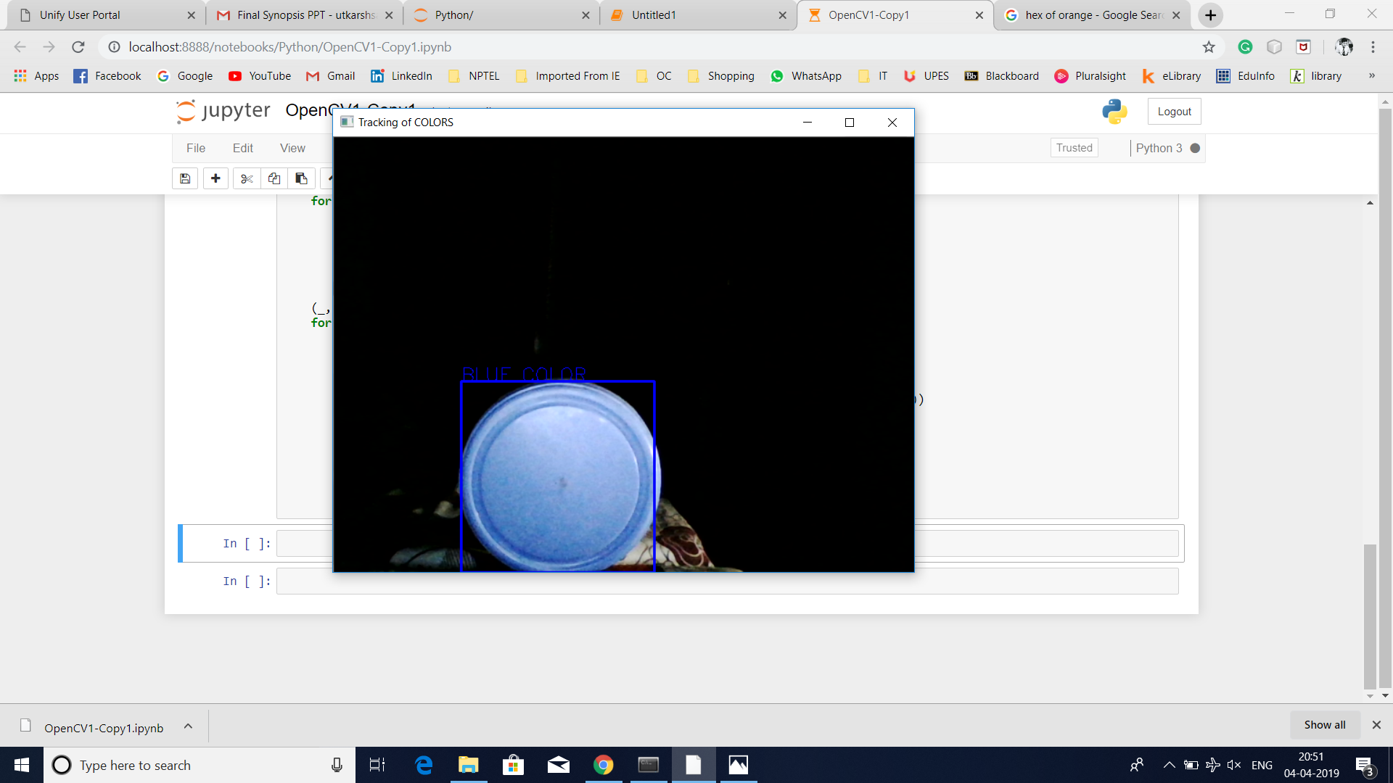
Progress Screenshots

Slide 7
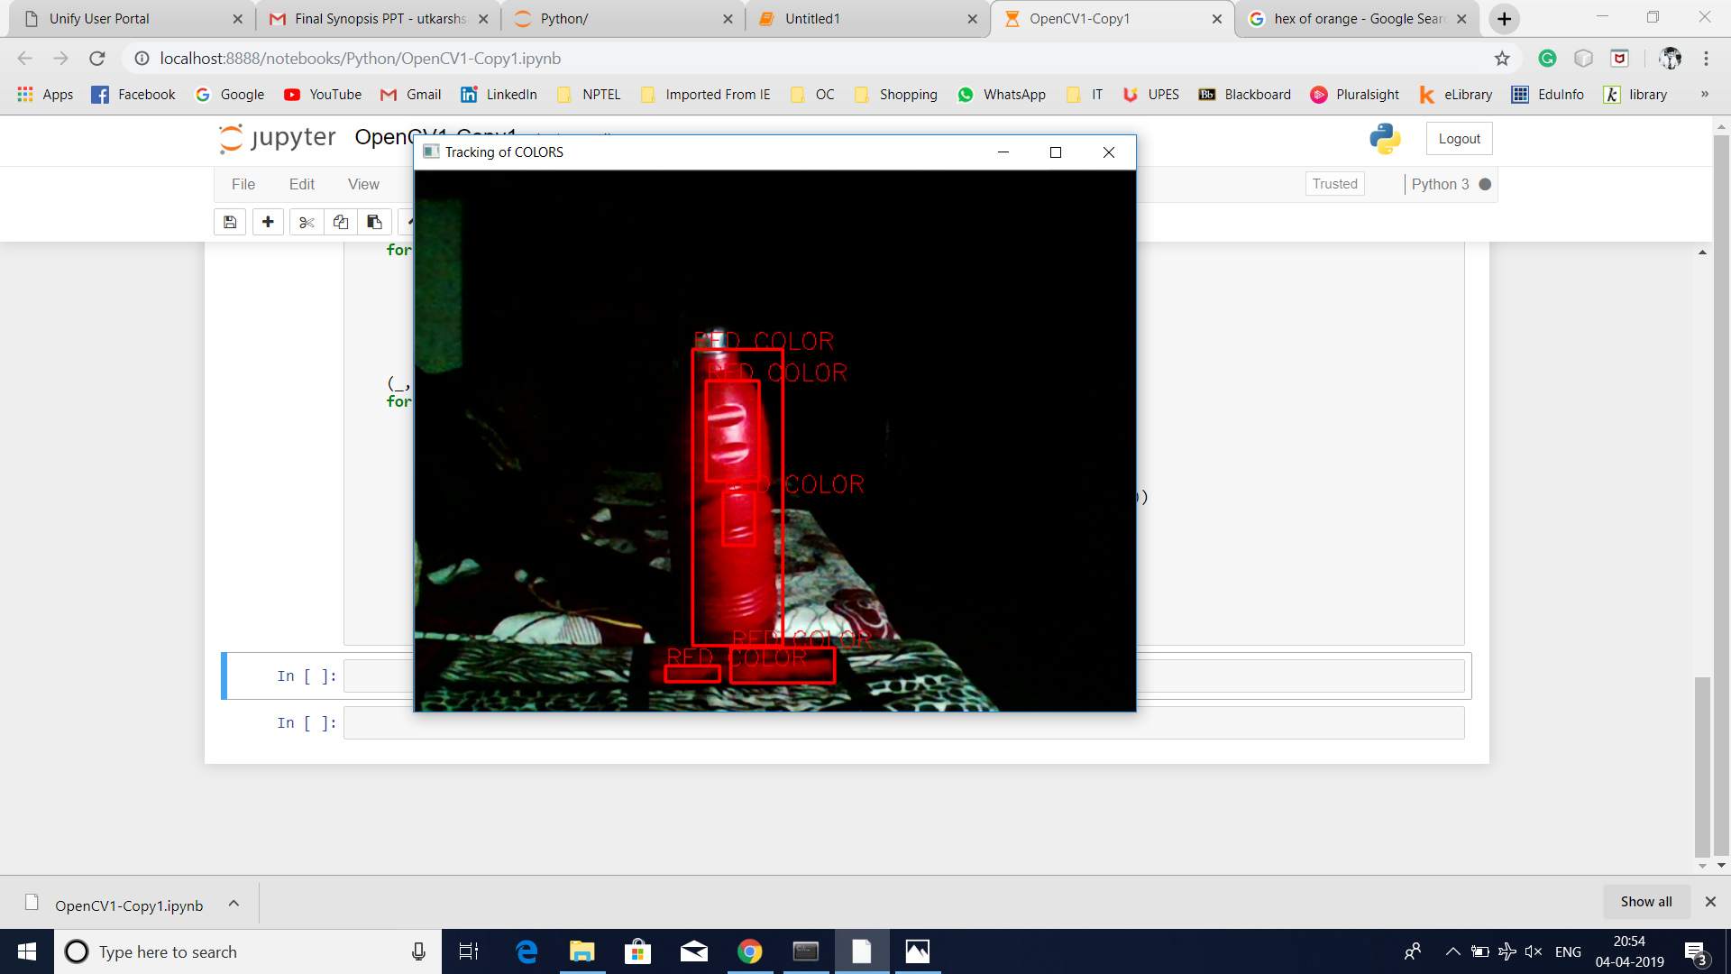
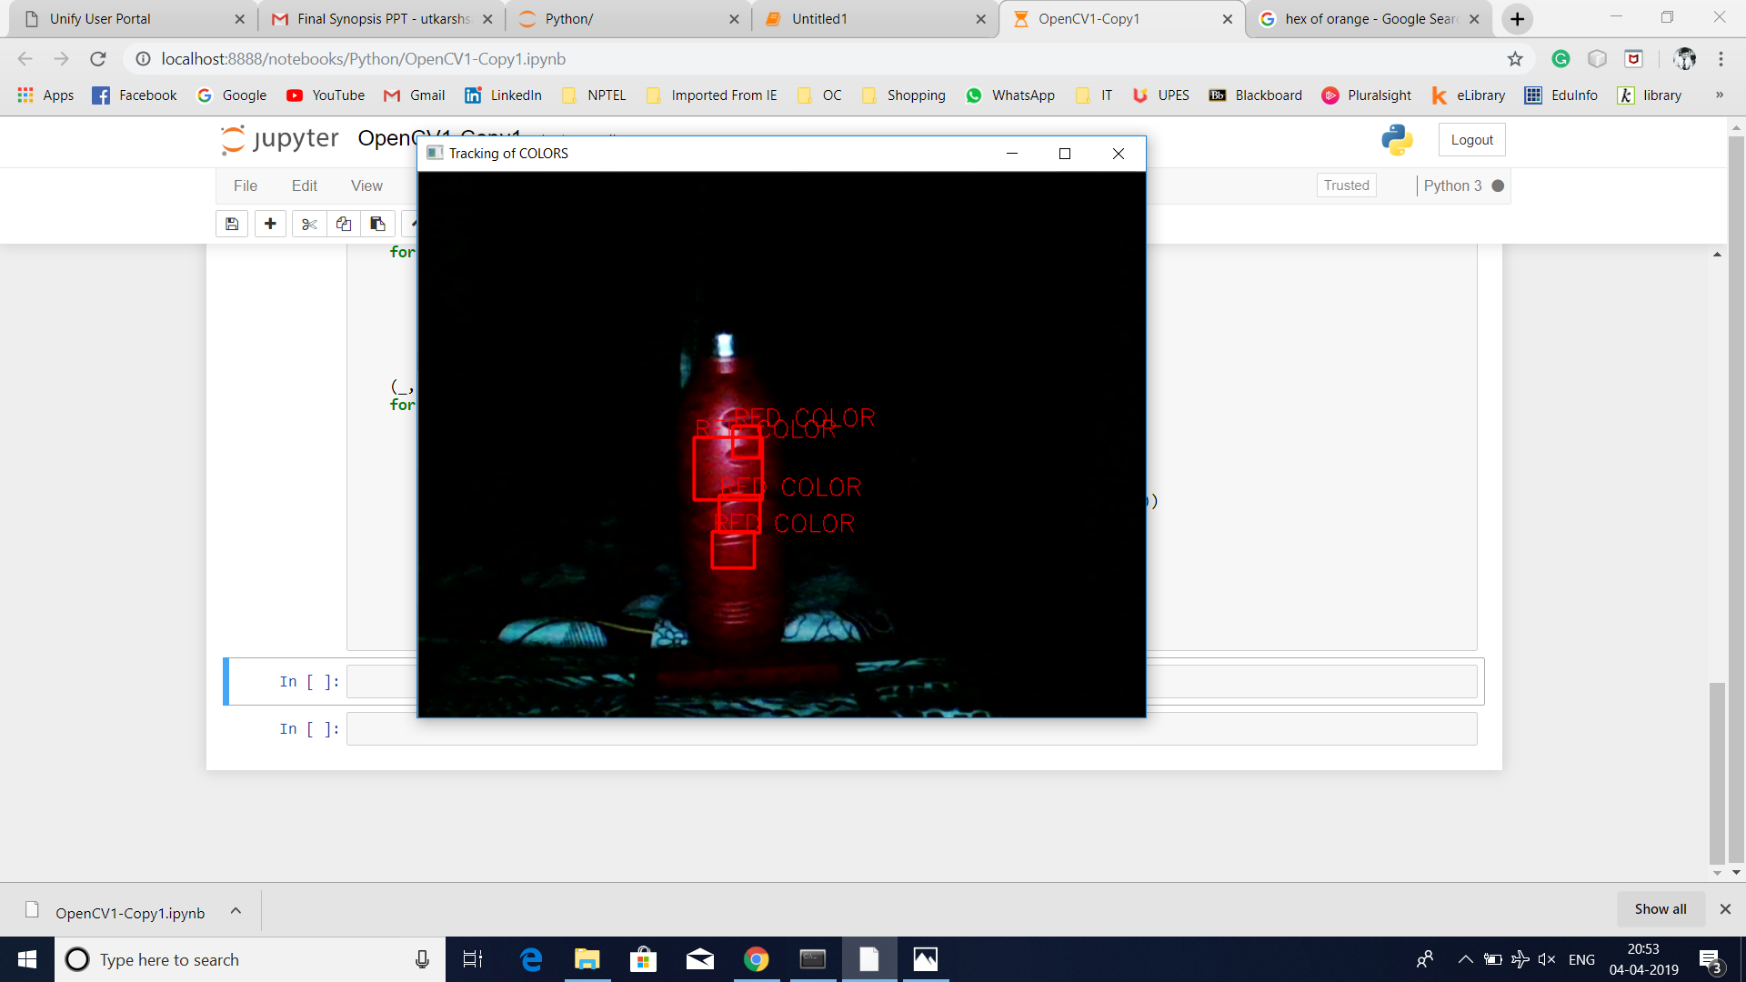

Slide 8
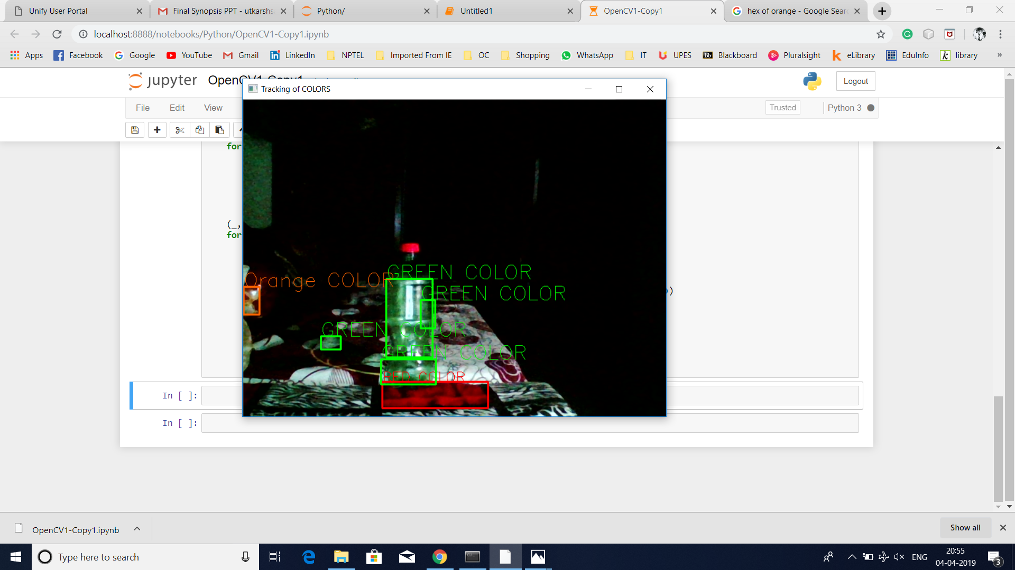

Slide 9
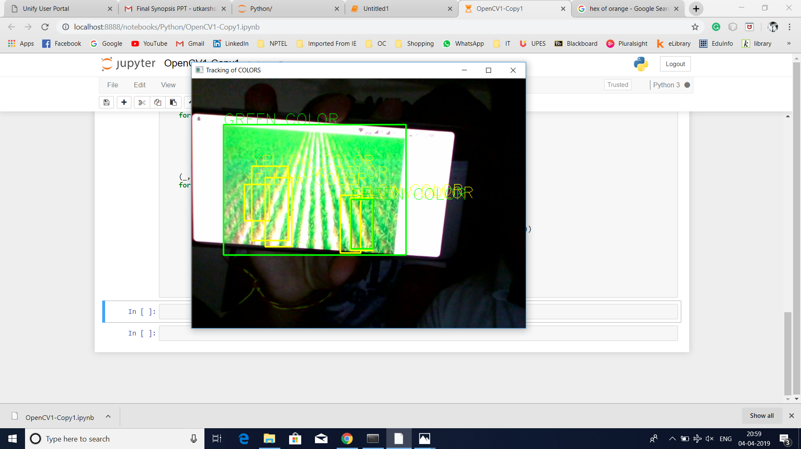
Real life example (proposed)

Slide 10
Thank you!!!

